Slide 1
Women in Technology: A Twitter Sentiment Analysis
Joanna Payoyo

Slide 2
Agenda
Background
Literature Review
Methodology
Key Findings
Conclusion
Limitations
Future Work
Notes:
1 min

Slide 3
Research Questions

Slide 4
Research Questions
• In general, is the sentiment about women in technology on Twitter positive or negative?
• Are different keywords statistically significantly different from each other?
• What days of the week or month do people have more positive or negative sentiment regarding this topic?
Notes:
2 min

Slide 5
Background Study

Slide 6
Background Study
Natural Language Processing
Sentiment Analysis
Notes:
3 min

Slide 7
Literature Review

Slide 8
Methodology

Slide 10
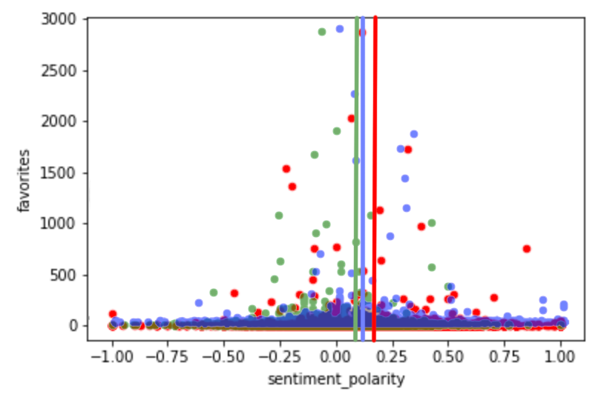
Keywords: Women, Female, Girl
Notes:
3 min

Slide 11
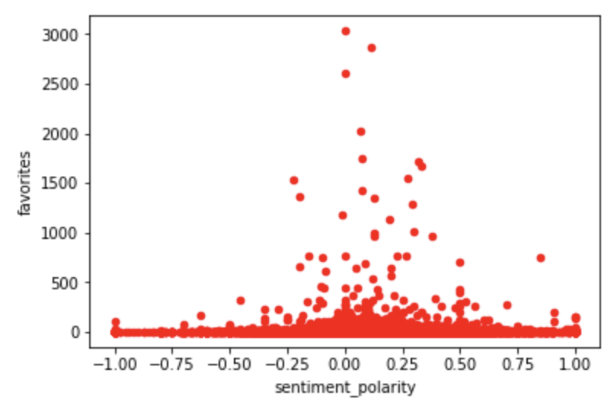
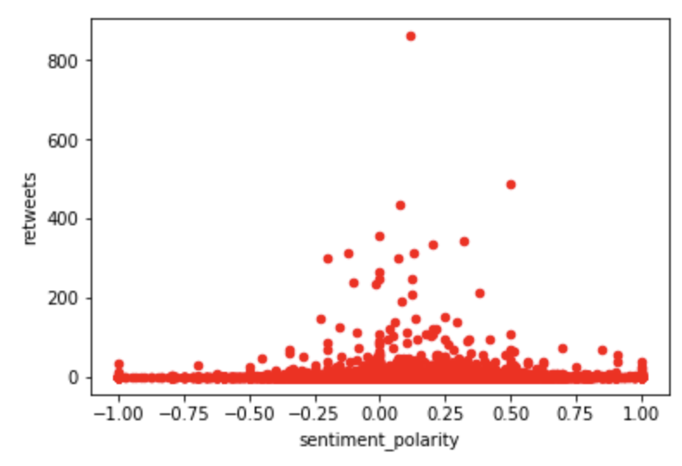
Retweets and Favourites
Notes:
3 min
Favourites - tweets people like
Retweets - tweets people want to engage with
Polarity Range of data → positive vs negative

Slide 12
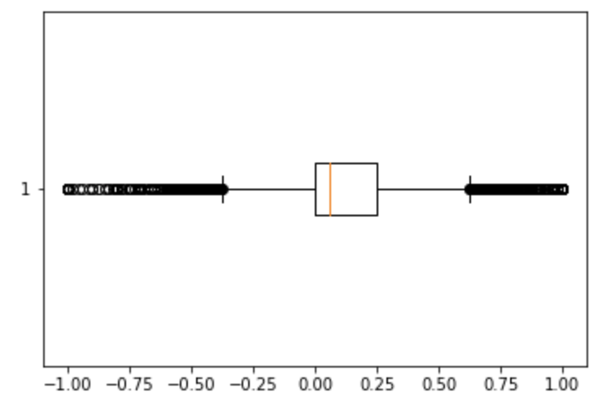
Retweets and Favourites
Notes:
3 min
Favourites - tweets people like
Retweets - tweets people want to engage with
Polarity Range of data → positive vs negative

Slide 13
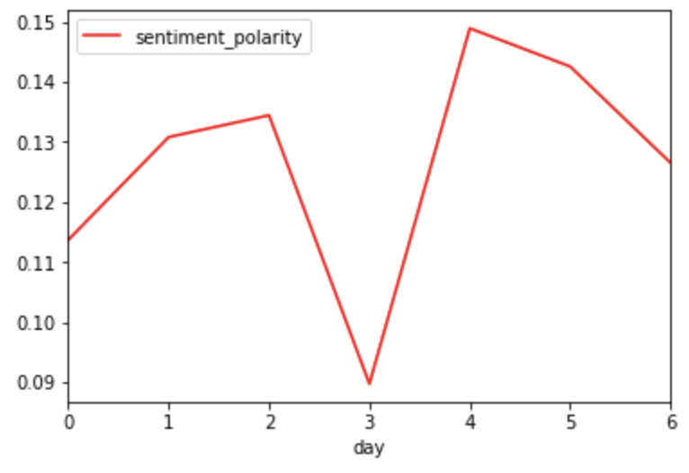
Days of the Week
Notes:
3 min

Slide 14
Conclusion

Slide 15
Limitations and Future Work

